Slide 1
Student information system
Project Presentation

Slide 2
Group members:
Syeda Alia Batool. (FA24-B1-CS-087)
Aleesha Muslim. (FA24B1-CS-064)
Aliza Seher. (FA24B1-CS-012)
Raheela Nisar. (FA24B1-CS-080)

Slide 3
Library files
Two library files are used in this program
stdio.h It is used for input/output functions.
string.h: This library is used when character arrays are used. It have many useful built- in functions specialized for strings.
A constant function is also declared in this section.
A constant can be declared with # sign and define keyword.
#include <stdio.h>
#include <string.h>
#define MAX_STUDENTS 100

Slide 4
Structures
A structure is declared in the code.
When a structure is declared with keyword “typedef “,it means we want to make a user defined data type.
In this code Student is a data type now.
Student students[MAX_STUDENTS];
Students variable is declared with Student data type showing it an element of the structure.
MAX_STUDENT is the constant already declared.

Slide 5
Structures
5 character arrays are declared in the code.
An int variable is also declared for storing roll numbers.
The number of characters they can store are maximum approximately. They can be less than specified but not a single character more than that.
typedef struct { char firstName[50]; char studentClass[20]; char semester[20]; int rollNumber;
} Student;

Slide 6
User built functions
User built functions are used for adding, deleting, updating, finding ,adding to file and remove from file.
Each function is separately made and called in when needed.
Void data type is used with them because they have to return no value.
Each function has been given two arguments:
Students [] to specify number of students.
Count pointer is used to specify location where the action is performed .
Count variable is used to check number of student on which action is performed.

Slide 7
User built functions
Void addStudent(Student students[], int *count);
void viewStudents(Student students[], int count); void findStudent(Student students[], int count); void updateStudent(); void deleteStudent(Student students[], int *count); void saveToFile(Student students[], int count); void loadFromFile(Student students[], int *count); void PrintMenu(Student students[], int *count);

Slide 8
Main function
An integer variable is declared in main function to count number of students.
Three user built functions are called in main.
loadFromFile(students, &studentCount); PrintMenu(students, &studentCount);
saveToFile(students, studentCount);
Each function has it’s specific purpose.
Two parameters are passed in each function, one to count and second to specify students.

Slide 9
Switch statement
In “printmenu “ function switch statement is used.
It checks the action user wants to perform . It takes integer variable and gives user 1-6 choices.
Switch (selectopt) { case 1: addStudent(students, count); break; case 2;
updateStudent();
break;
Similarly cases upto six.

Slide 10
Functions
User built functions simply use printf and scanf statements to add students , update students ,delete students and find students.
Arrays are also used to store data.
Then the whole is stored in a file using concept of filing.

Slide 11
Filing
A file named “students” ,is opened in writing mode to store the data added and updated by user.
The file is then closed after storing data.
In next function it is reopened in read mode .
It reads the data of specified student .
And is closed again.

Slide 12
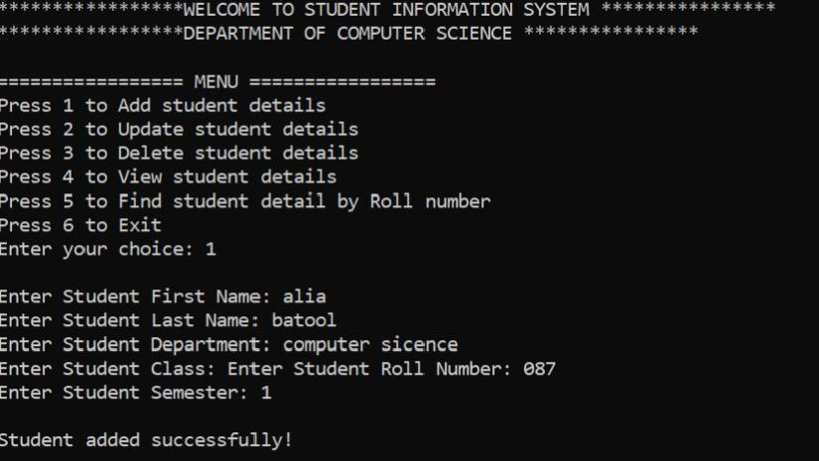
Output

Slide 13
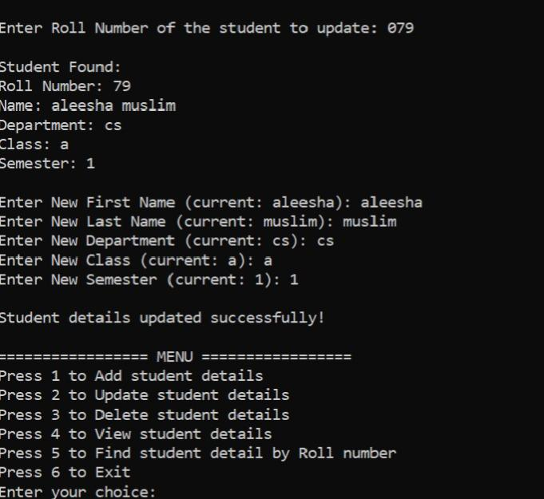
Output

Slide 14
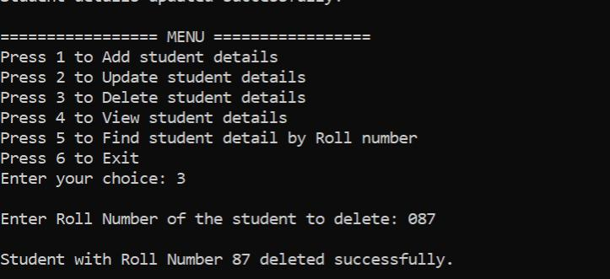
Output

Slide 15
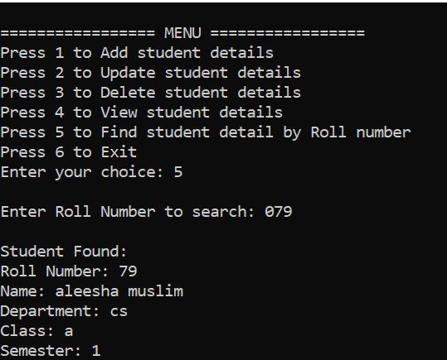
Output

